Slide 1
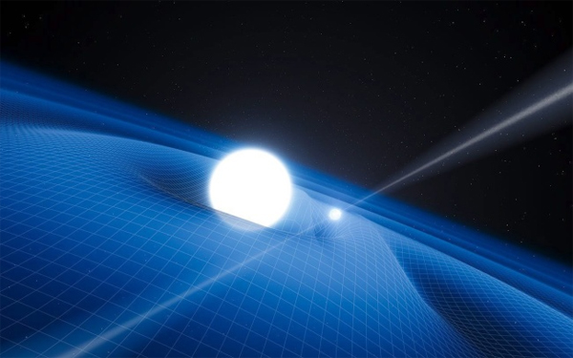



Introduction to atomic clocks
J. Mauricio López R.
CENTRO NACIONAL DE METROLOGÍA, CENAM
Centro Nacional de Metrología, CENAM, km 4.5 Carretera a los Cues, El Marques, Qro., www.cenan.mx

Slide 2
What is time?

Slide 3
Time is what clocks measure
Albert Einstein

Slide 4
Time is what clocks measure
Albert Einstein

Slide 5
Clock = Oscillator + Counter

Slide 6

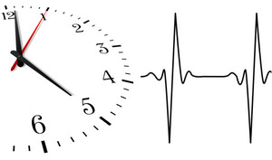
The heart as the closest clock of men
Clock = Oscillator + Counter

Slide 7
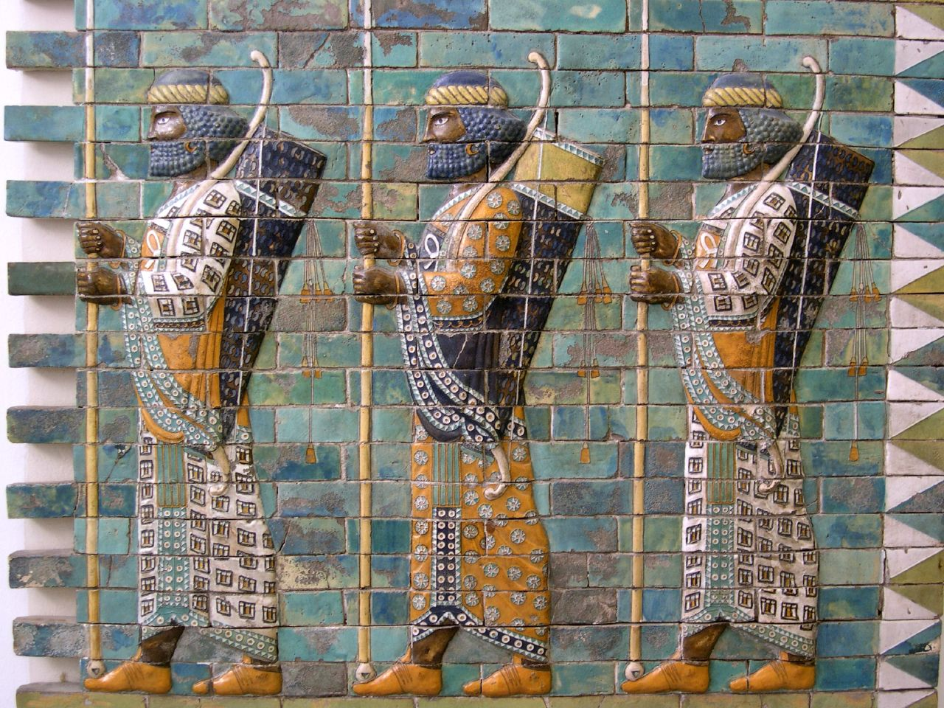
Time measurement is the oldest measurement of humankind
nearly 5000 years old

Slide 8
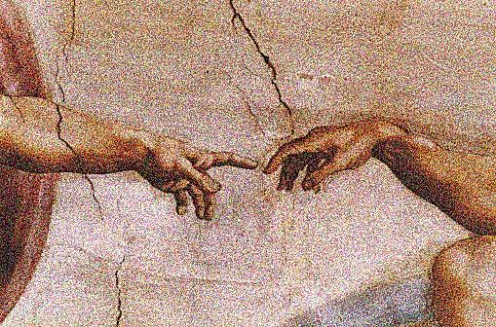
The second, the most anthropometric unit

Slide 9
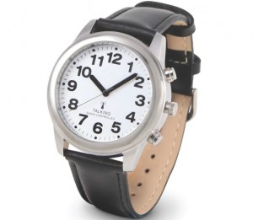
In clocks are resumed our civilization deepest past and our best science
Slaves of our past and of the time

Slide 10
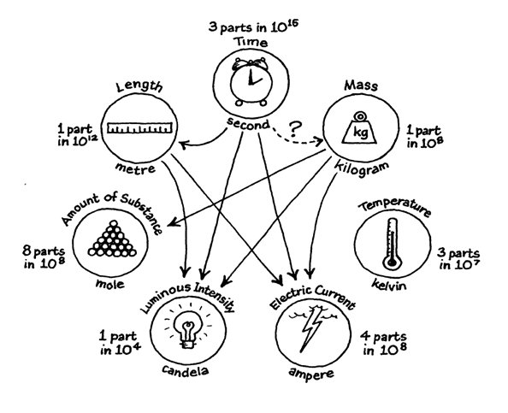
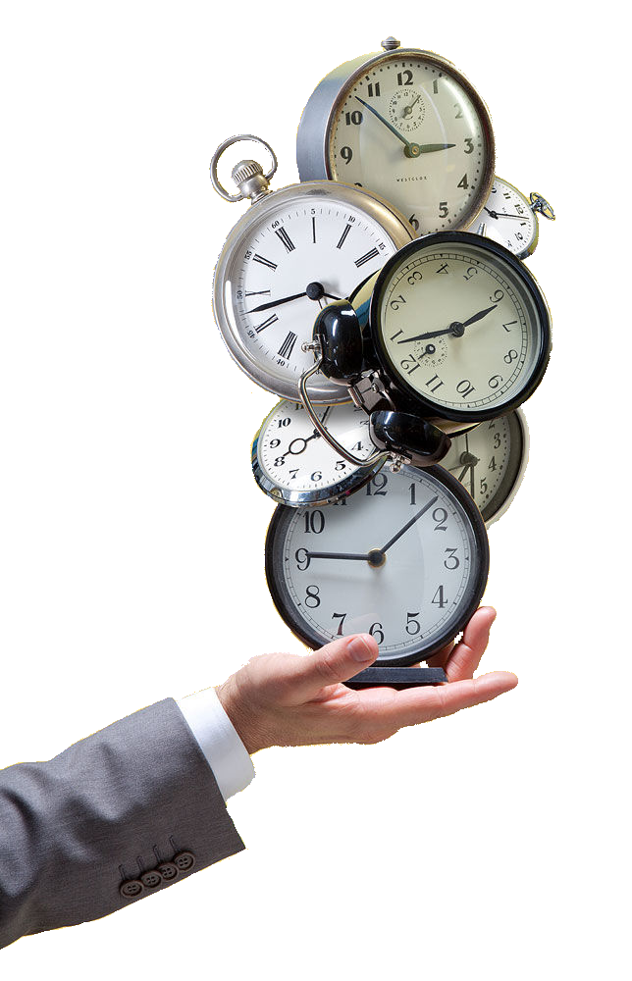
THE TWO FACES OF TIME MEASUREMENT
Scientific and fundamental research
Technological and practical applications
The current SI
Time is the most accurate measurement
TIME
The most measured physical quantity

Slide 11
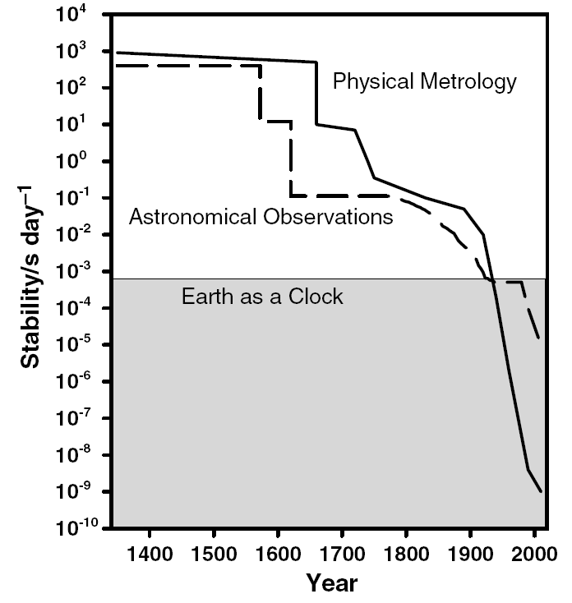
The last 600 years of time measurement
Dennis D. McCarty, Evolution of Time Scales from astronomy to physicasl metrology, Metrologia 48 (2011), S132 – S144.

Slide 12
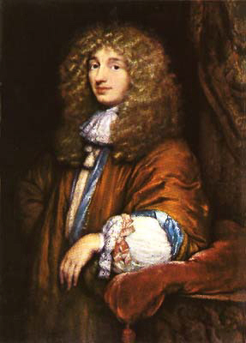
The last 600 years of time measurement
Accurate pendulum clock and the equation of time
Christiaan Huygens (1660)
Christiaan Huygens
(1629 – 1695)

Slide 13

The last 600 years of time measurement
John Harrison chronometers
Longitude Act of 1714

Slide 14
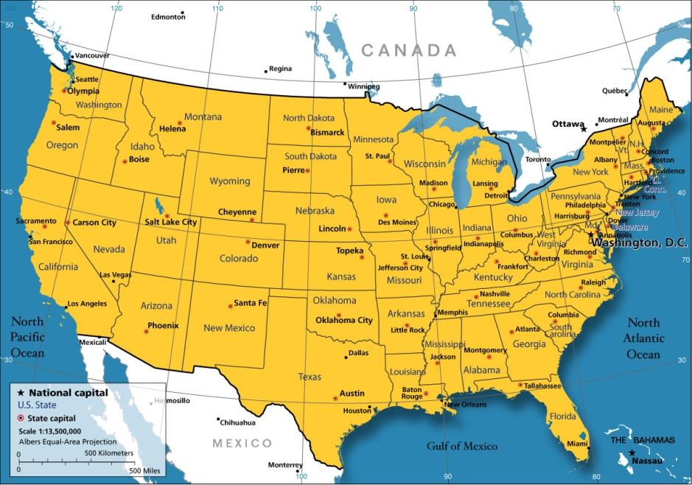
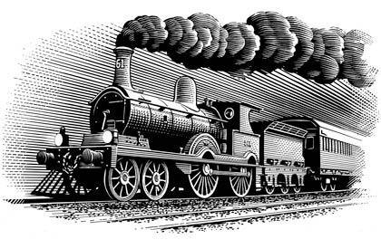
The last 600 years of time measurement
Greenwich meridian as interational reference (1884)

Slide 15
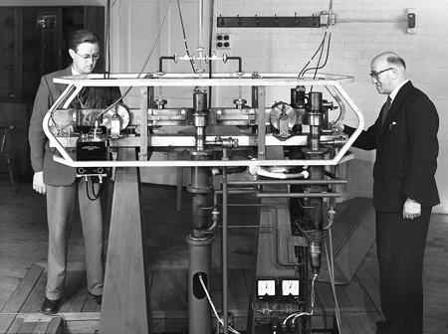
The last 600 years of time measurement
First atomic clock at NPL (1957)
Louis Essen and his NPL Cs atomic clock

Slide 16
The last 600 years of time measurement
The second is the duration of 9 192 631 770 periods of the radiation corresponding to the transition between the two hyperfine levels of the ground state of the Cesium 133 atom.
Atomic definition of the second, 1967
Resolution 1, 13th CGPM, 1967

Slide 17
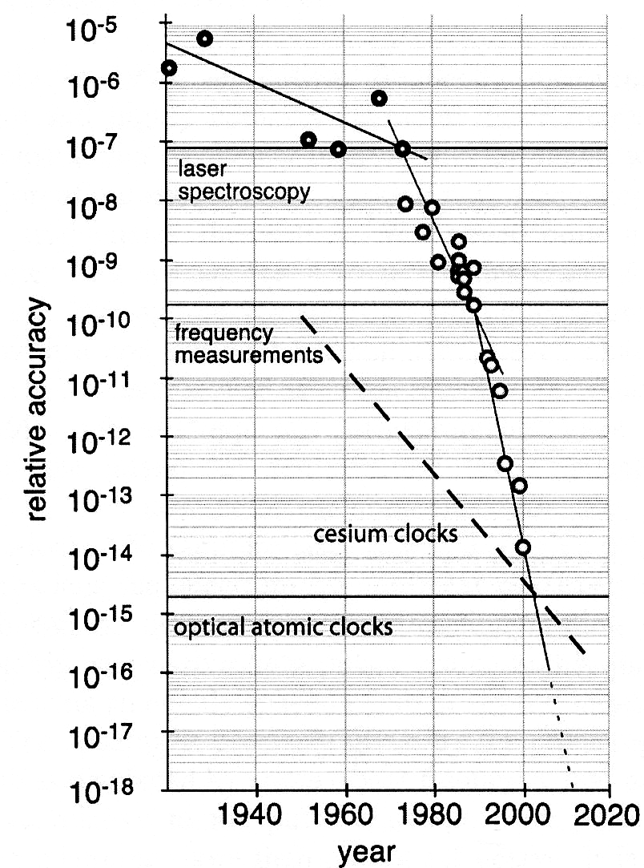
The last 600 years of time measurement
Progress at one order of magnitud per decade
Atomic clocks era

Slide 18
The last 600 years of time measurement
Progress at one order of magnitud per decade
Ultracold matter and Cs fountain clocks

Slide 19
The last 600 years of time measurement
Progress about four orders of magnitud per decade !!
Frequency combs and optical atomic clocks

Slide 20
The base units of the International System of units

Slide 21
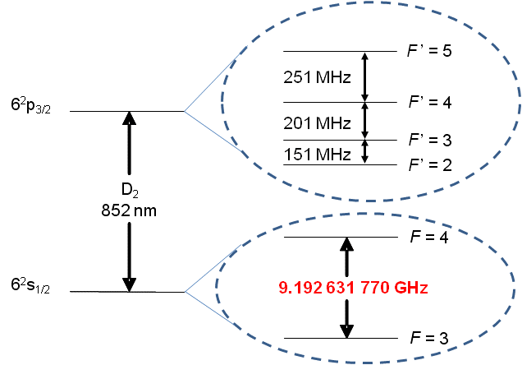
Cs-133 Atomic Clocks
The second is the duration of 9 192 631 770 periods of the radiation corresponding to the transition between the two hyperfine levels of the ground state of the Cesium 133 atom.
Hiperfine structure
Ground state

Slide 22
What is an atomic clock

Slide 23
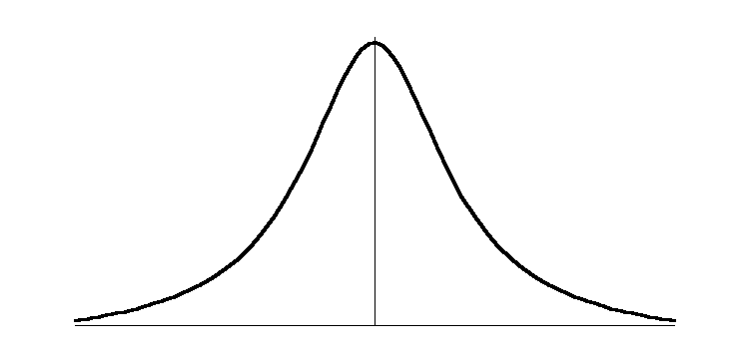
Disciplined oscillators
The basic concept of an atomic/optical clock
δν_{L}
δν_{L}
δν_{A}
ν_{L}
ν_{L}
ν
ν₀
ν_{L} ≈ ν₀

Slide 24
Frequency Stability of an Atomic Clock
Δν
ν_{o}
Allan Deviation

Slide 25
Strategies to develop better atomic clocks
Cold atoms and very long lifetime on excited states
Optical Frequencies
Large amount of atoms
Large averaging times / robust systems

Slide 26
Nuclear Magnetic Resonance and atomic clocks

Slide 27
Spin invertion by the action of a rotating magnetic field Rabi´s Method
z
Larmour Frequency
ω₀
φ
Constant magnetic field

Slide 28
Spin invertion by the action of a rotating magnetic field Rabi´s Method
z
Larmour Frequency
ω₀
ω
φ
Constant magnetic field
Rotating magnetic field perpendicular to H₀

Slide 29
Spin invertion by the action of a pulsed rotating magnetic field Ramsey´s Method
z
Larmour Frequency
ω₀
ω
φ
Constant magnetic field
Rotating magnetic field perpendicular to H₀
Pulsed!

Slide 30
Ramsey Method
Generador de
Microondas
Lazo de
amarre
Vacío
Cavidad de Ramsey
Campo Magnético Inhomogéneo (Campo A)
Campo Magnético Inhomogéneo (Campo B)
Contenedor con Cesio 133
Filamento
Incandescente (Ionizador)
Detector
CampoMagnético Constante
(Campo C)

Slide 31
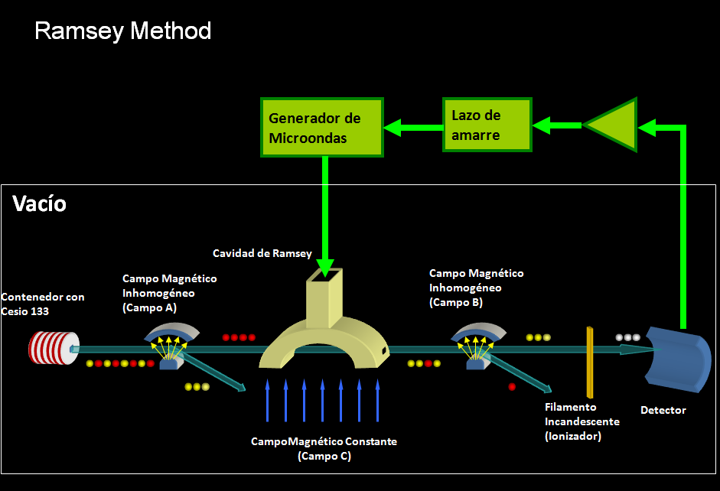
First atomic clocks (1957)

Slide 32
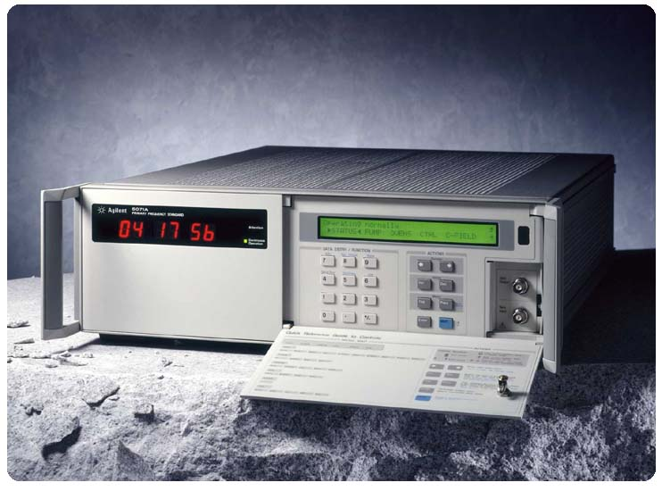

Commercial available Cs atomic clock using the magnetic selection of N. Ramsey

Slide 33
Cs-133 Optical pumping
F’=5
11 sublevels
F’=4
251MHz
9 sublevels
6²P_{3/2}
F’=3
200MHz
7 sublevels
F’=2
150MHz
5 sublevels
≈100GHz
F’=4
9 sublevels
6²P_{1/2}
ENERGY
F’=3
1167MHz
7 sublevels
Not at scale
≈850nm
≈894nm
F’=4
9 sublevels
6²S_{1/2}
9.192631770 GHz
F’=3
7 sublevels
Coulomb
+
Spin-Orbit
+
Spin-Spin
+
Zeeman Effect
INTERACTION

Slide 34
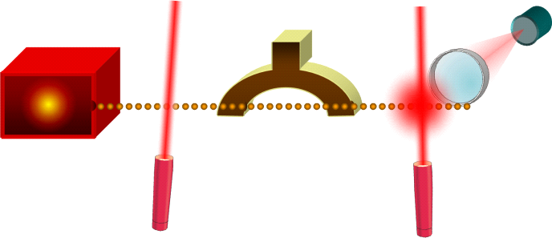
Ramsey method with optical pumping (1985)
Microwave
Oscillator
Phase lock
loop
Detector
Ramsey Cavity
Cs Oven
Pumping Laser
Detection Laser

Slide 35
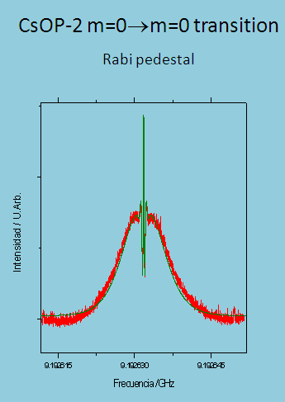
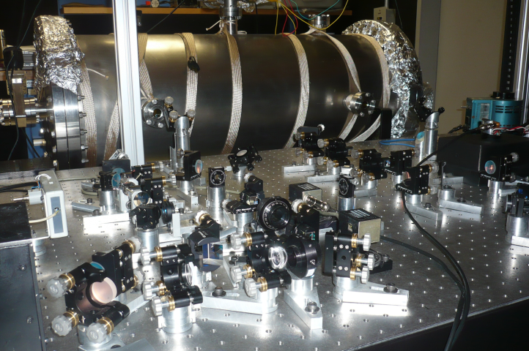
Optically pumped thermal Cs beam clock CENAM CsOp-2
180 Hz

Slide 36
Doppler Cooling
A two quantum states model
E₂
Energy
E₁
Laboratory reference frame
v
ν_{F}=ν₀-ε
ν_{F}=ν₀-ε
ν₀

Slide 37
Doppler Cooling
A two quantum states model
Atom´s reference frame
ν_{L}= ν_{F} - k·v + …<< ν₀
ν_{R} = ν_{F} + k·v + … ≈ ν₀
ν₀

Slide 38
Doppler Cooling
A two quantum states model
Doppler limit
Cesio-133
Sodio
h ≈ 6,6×10⁻³⁴ J⋅s
k_{B} ≈ 1,3×10⁻²³ J/K

Slide 39
Phys. Rev. Lett. 61, 169–172 (1988)
[Issue 2 – 11 July 1988 ]
Observation of atoms laser cooled below the Doppler limit
Paul D. Lett, Richard N. Watts, Christoph I. Westbrook, and William D. Phillips
Electricity Division, National Bureau of Standards, Gaithersburg, Maryland 20899
Phillip L. Gould
Department of Physics, University of Connecticut, Storrs, Connecticut 06268
Harold J. Metcalf
Department of Physics, State University of New York at Stony Brook, Stony Brook, New York 11794
Received 18 April 1988
We have measured the temperature of a gas of sodium atoms released from ``optical molasses'' to be as low as 43±20 µK. Surprisingly, this strongly violates the generally accepted theory of Doppler cooling which predicts a limit of 240 µK. To determine the temperature we used several complementary measurements of the ballistic motion of atoms released from the molasses.
©1988 The American Physical Society

Slide 40
The Cs-133 atom as a two level quantum system
F´=5
λ ≈ 852 nm
Energy
F=4

Slide 41
The Cs-133 atom as a multilevel quantum systems
m = -5
m = 0
F´=5
m = +5
Not at escale
λ ≈ 852 nm
Energy
m = +4
m = 0
F=4
m = -4
B / Gauss
0
1

Slide 42
Temperatures below the Doppler limit
x
0
λ/4
λ/2
z
linear
σ⁻
linear
σ⁺
linear
σ⁻
y
m = -3/2
m = -1/2
m = +1/2
m = +3/2
J = 3/2
J = 1/2
m = -1/2
m = +1/2

Slide 43
Stark effect
linear
σ⁻
linear
σ⁺
σ⁻
linear
0
g_{+½}
Energy
g_{-½}
z
0
λ/8
λ/4
3λ/8
3λ/8
λ/2
5λ/8
Position

Slide 44
Sisyphus effect and temperatures below the Doppler limit
Energy
g_{-½}
g_{+½}
z
λ/8
λ/4
3λ/8
λ/2
5λ/8

Slide 45
Ramsey Method + ultracold Cs atoms
ΔE • Δt ≥ h/4π
Δν • Δt ≥ 1/4π
Transition probability
ν₀≈10¹⁰Hz
Δν ≈ 1Hz
<δν/ν> ≈10⁻¹⁵
ν₀
Frequnecy
Δν

Slide 46
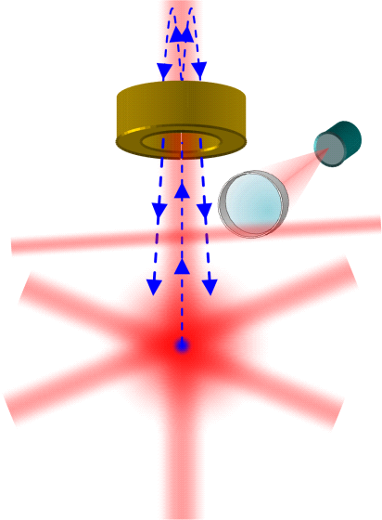
Cs Fountain Clock
(1990)
Wayne M. Itano, Norman F. Ramsey, Accurate Measurement of Time, Scientific American, July 1993.
Microwaves cavity
Detector
Detection laser
Optical molases
Cooling beams

Slide 47
Clock transition
Wayne M. Itano, Norman F. Ramsey, Accurate Measurement of Time, Scientific American, 1993.
Resolution of the peak

Slide 49
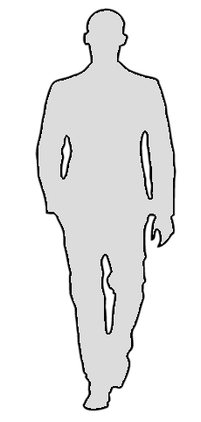
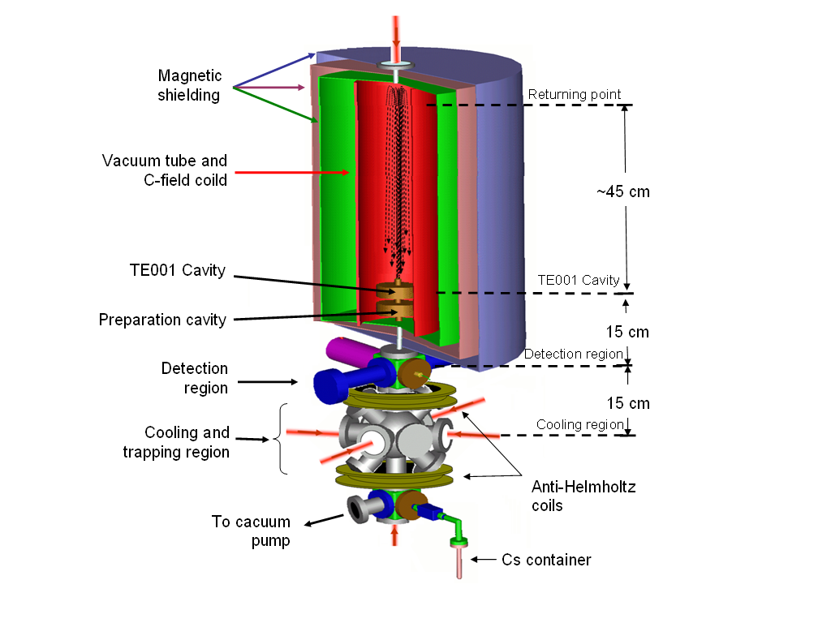
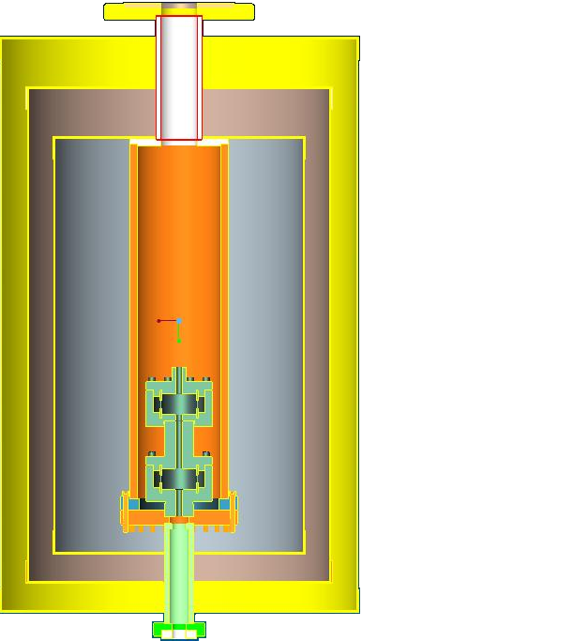
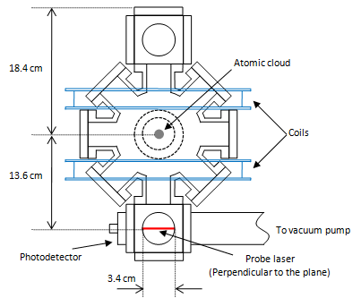
CENAM CsF-1
physical package
35.0 cm
22.0 cm
33.0 cm

Slide 50
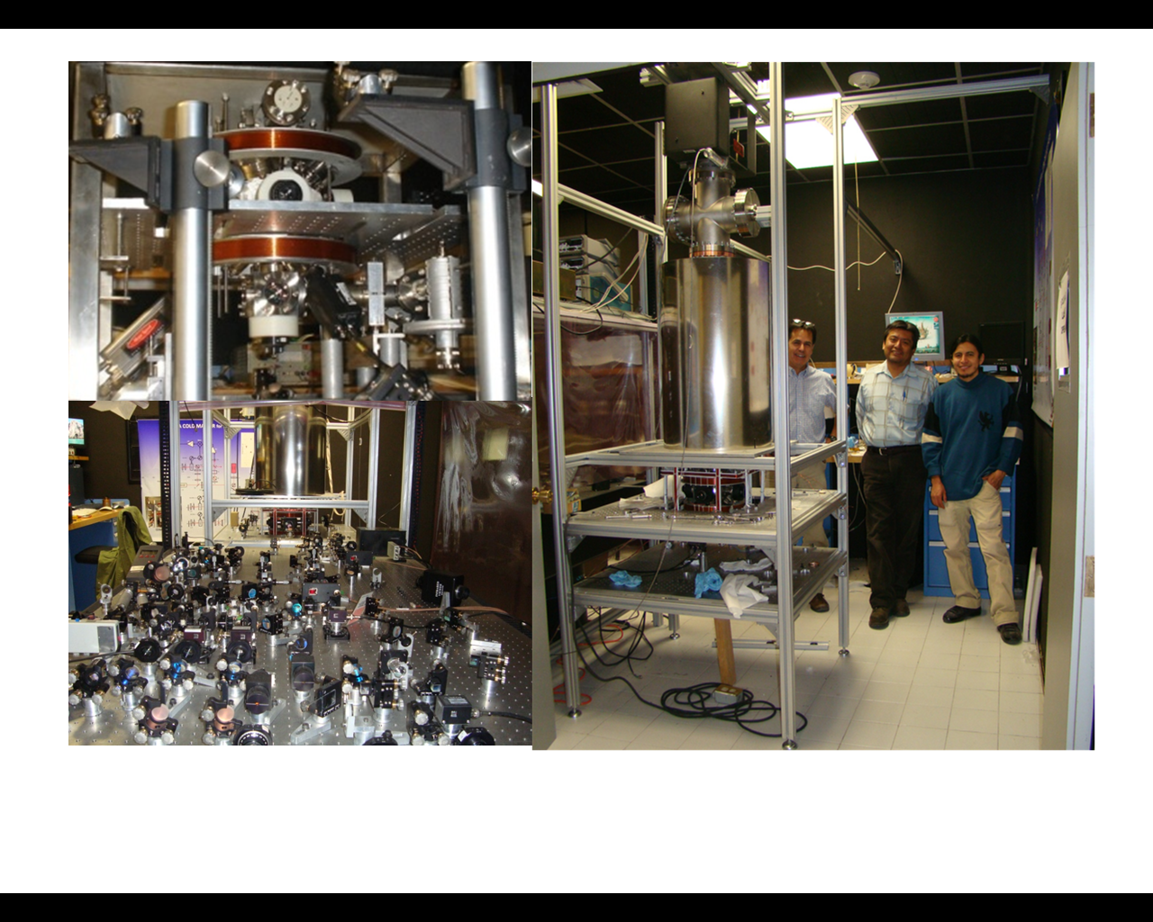
Cesium fountain clock
CENAM CsF-1
MOT
Optical system
Physics package

Slide 51
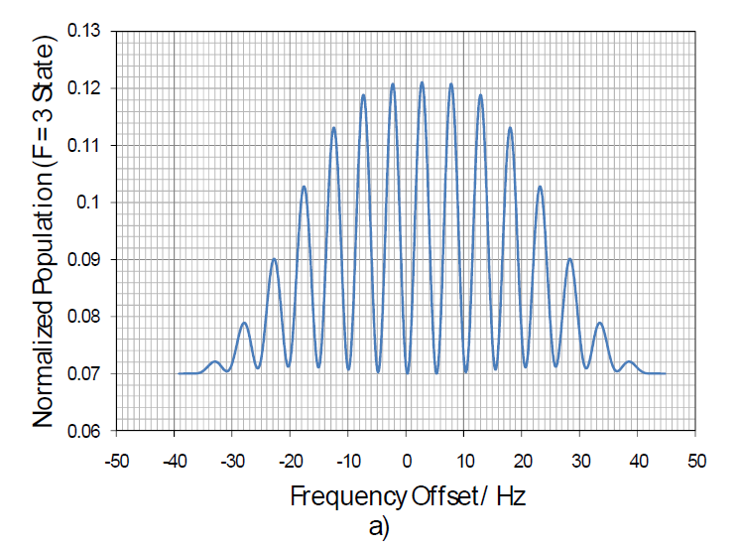
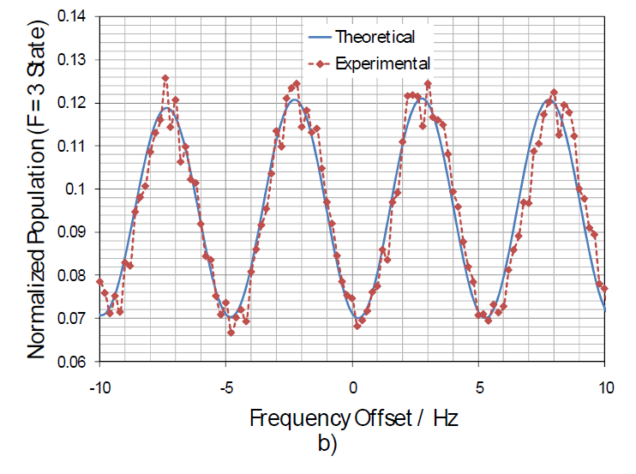
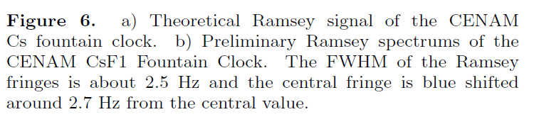

Slide 52
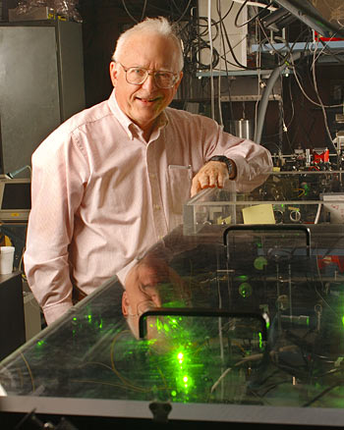
Time is the most powerful metrological variable
JOHN HALL, Nobel Prize in Physics 2005

Slide 53
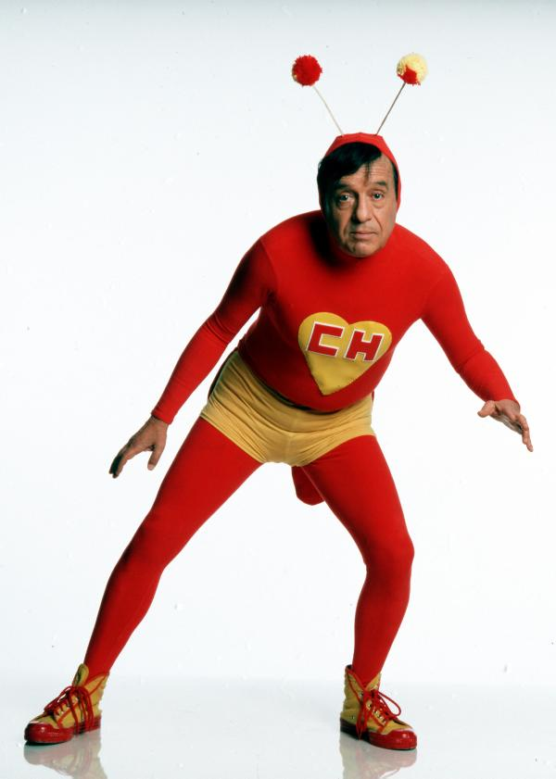
NO CONTABAN CON MI ASTUCIA!!

Slide 54
Introduction to atomic clocks
J. Mauricio López R.
CENTRO NACIONAL DE METROLOGÍA, CENAM
THANK YOU!!
Centro Nacional de Metrología, CENAM, km 4.5 Carretera a los Cues, El Marques, Qro., www.cenan.mx

Slide 55
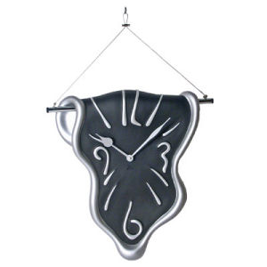
The second is the duration of 9 192 631 770 periods of the radiation corresponding to the transition between the two hyperfine levels of the ground state of the Cesium 133 atom.

Slide 56
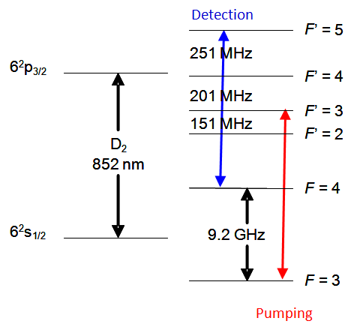

Detector
Cavidad de
Horno
microondas
de Cs
Láser de
Láser de
bombeo
detección
180 Hz
CENAM thermal Cesium beam atomic clock

Slide 57
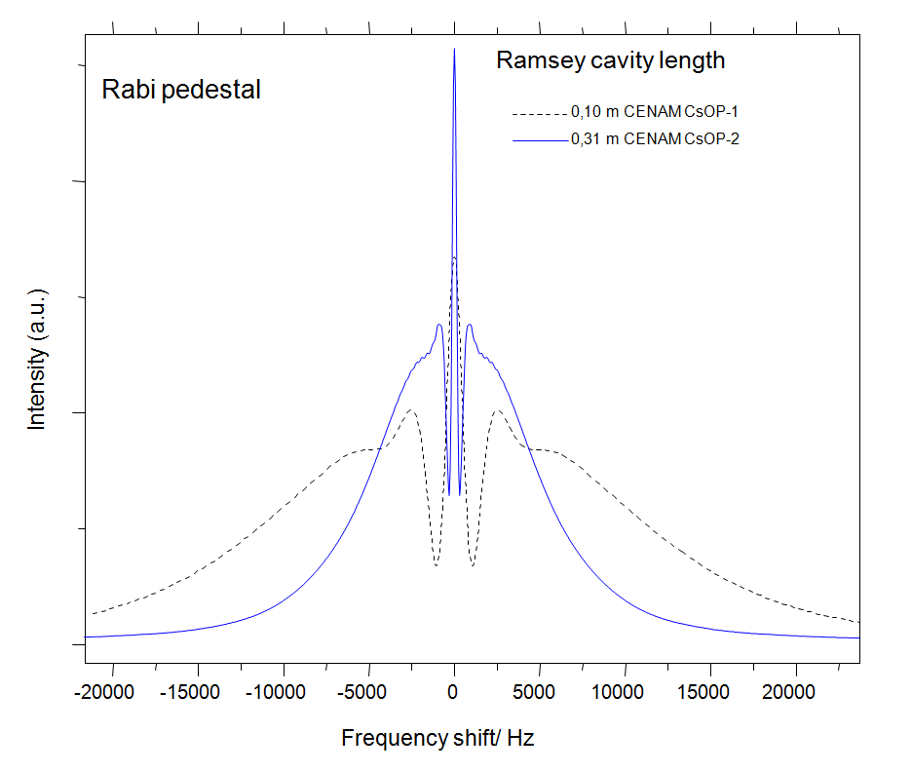
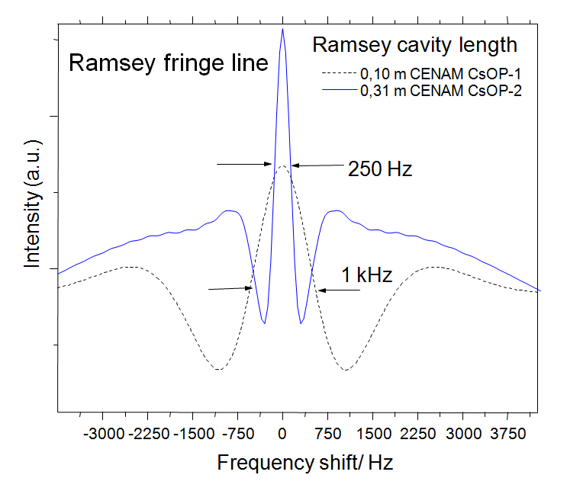
Rabi pedestal comparison between CENAM CsOP-1 and CENAM CsOP-2
Ramsey fringe line comparison between CENAM CsOP-1 and CENAM CsOP-2.

Slide 58
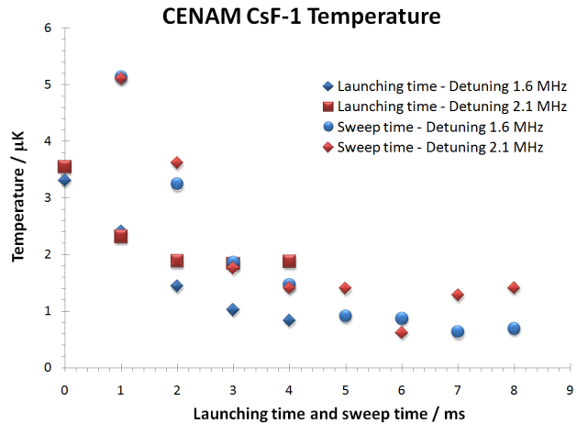
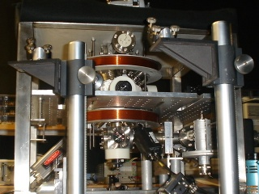
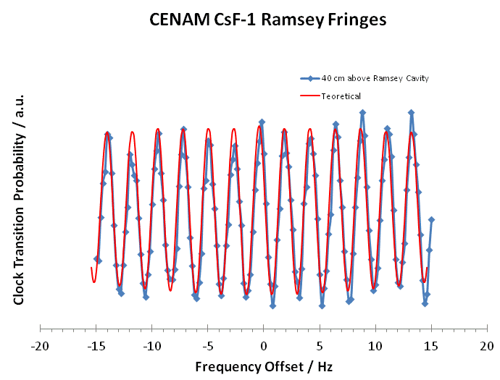
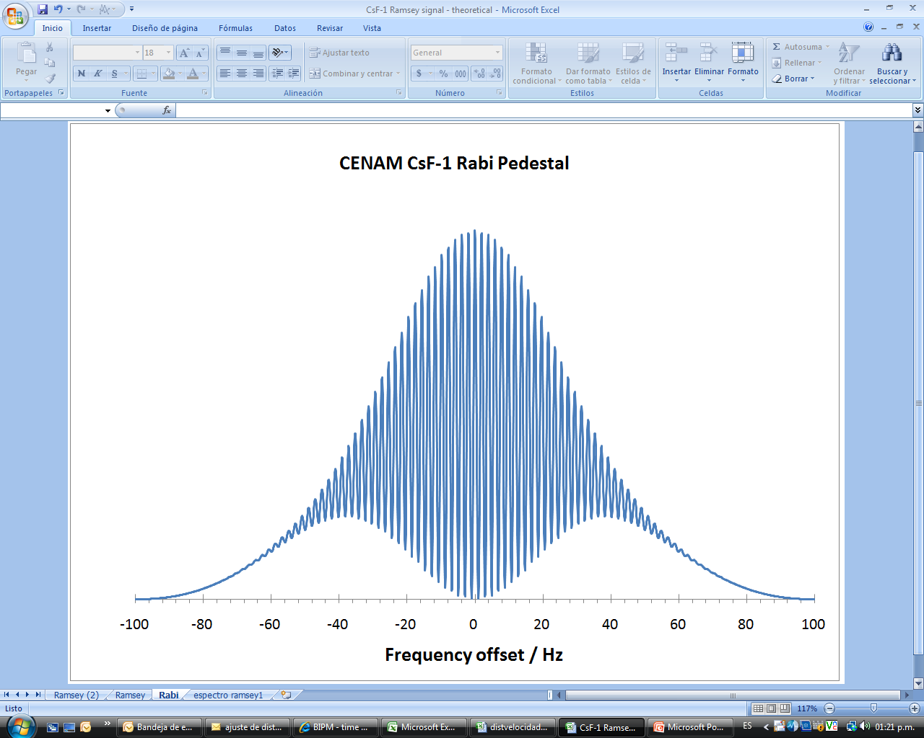
Microwave cavity
Detector
Detection laser
Optical molases
≅ 600 nk
Cooling beams
CENAM CsF-1
CENAM Cs Fountain Clock

Slide 59
CENAM CsF-1
physical package
35.0 cm
22.0 cm
33.0 cm

Slide 60
CENAM Cesium clocks
CsOP-1
CsF-1
Probabilidad de transición
CsOP-2
Frecuencia

Slide 61
CENAM Cesium clocks
CsOP-1
CsF-1
CsF-1
Probabilidad de transición
CsOP-2
Frecuencia

